Slide 1

AUDIO AMPLIFIER
Mentor:
Mr.R.Varun Prakash BE, ME, (PhD)
Project by:
Sivabalan R ( II ECE-B)
Abinesh M A ( II ECE-B)

Slide 2
AIM:
To design and implement a high-efficiency audio amplifier capable of delivering optimal power output for audio applications.
OBJECTIVE:
To achieve efficient power amplification using PWM control, with minimal heat dissipation and clear audio output.

Slide 3
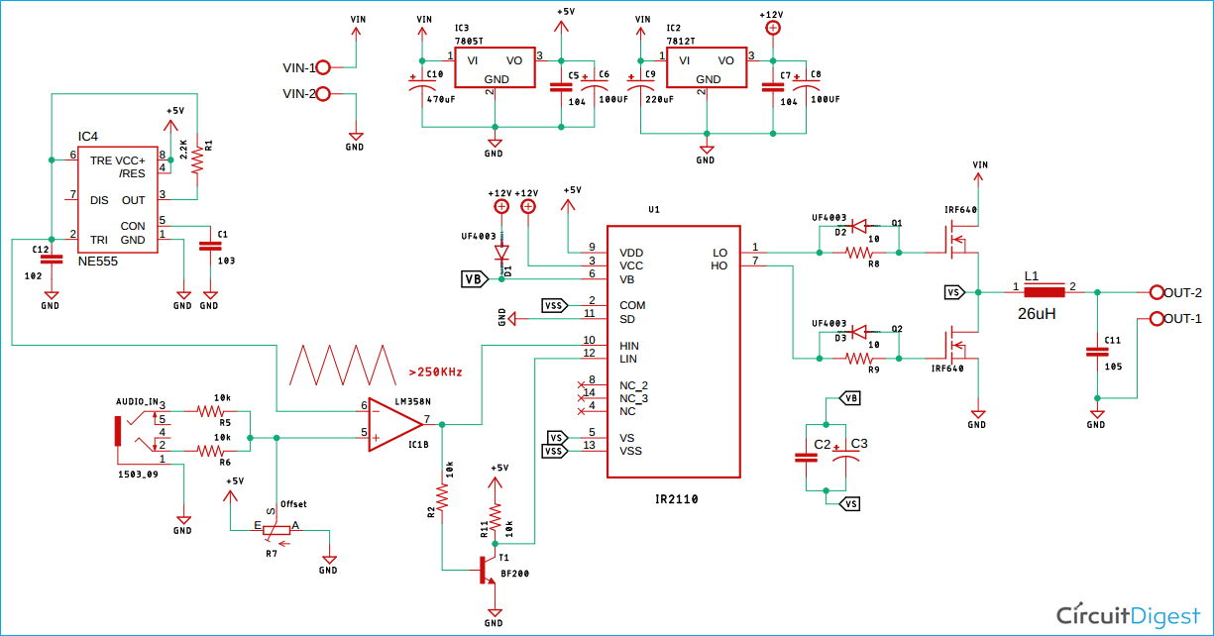

Circuit Diagram:

Slide 4
Required components:
(1) IR2110 IC
(2) NE555 Timer IC
(3) LM7812
(4) LM7805
(5) LM358 (OP-AMP)
(6) IRF640 MOSFET’s
(7) 10K Trim POT
(8) UF4007 Diode
(9) 26 uH Inductor
(10) Screw terminal
(11) Capacitors
(12) Resistors

Slide 5
Working :
Power Supply:
Regulated 5V and 12V supplies are provided by 7805 and 7812 regulators to power
the circuit components.
Oscillator (NE555):
Generates a stable frequency pulse wave that controls the switching in the amplifier.
Audio Signal Processing (LM358):
The audio input is converted into a PWM signal by comparing it with a reference
signal in the op-amp.
PWM Frequency (>250kHz):
The generated PWM signal is at a high frequency for smooth switching of MOSFETs.
MOSFET Driver (IR2110):
Drives high-side and low-side MOSFETs (IRF640) for switching based on the PWM signal.
MOSFET Switching:
The MOSFETs rapidly turn on and off, modulating the power to the speaker.
LC Filter:
An LC circuit (26μH inductor) changes the PWM signal back to analog form before
outputting it to the speaker.
Protection: Diodes D2 and D3 protect the MOSFETs from voltage spikes.

Slide 6
APPLICATION’s:
Audio Amplification: Used in home theaters, car audio systems, and portable
speakers for efficient sound amplification.
Public Address Systems: Used in amplifiers for large-scale sound systems where
efficiency is crucial.
Subwoofers : Commonly used to drive subwoofers, delivering high power without
excess heat generation.
FEATURE’s
High Output Power: Capable of delivering 30W for 4 ohm speaker & more for
higher supply input.
Low Distortion: Proper filtering ensures clean audio output with minimal distortion.
Compact Design: The high efficiency allows for smaller heat sinks and compact design.

Slide 7
Thank You

